Slide 1

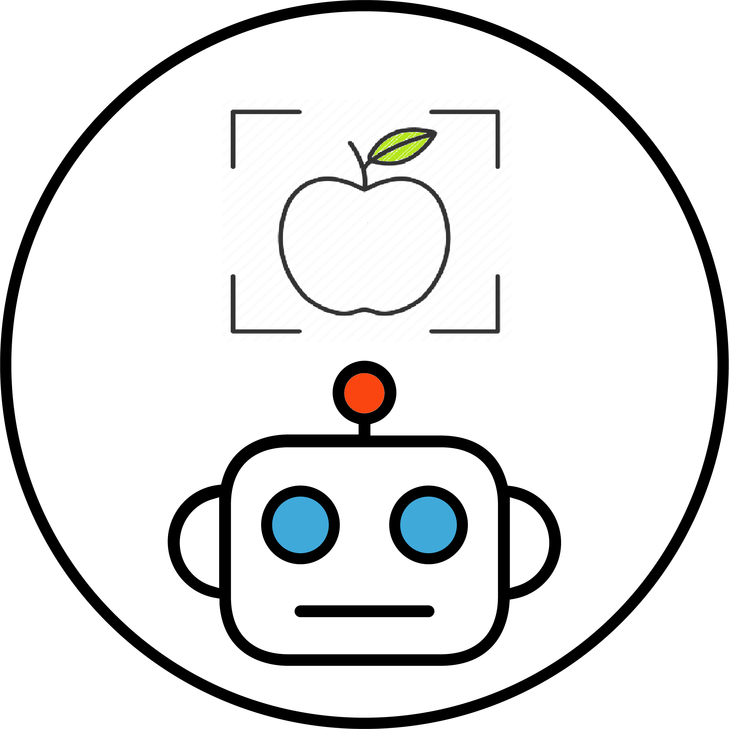
Find it!
See it,
Snap it,

Slide 2
The app

Slide 3
The components
The Android app
The app is the interface that lets the user take a picture of the subject he wants to recognise. The application connects the smartphone with the remote server, sending the request with the classification problem.
The remote server
The server holds the neural network. When it receives a request with a picture from the Android app, it forwards it to the model. When the server receives the response, it sends it back to the Android app which displays the text on screen.
The neural network
The model has the task to recognise the subject of the picture. It is stored and running on the remote server.

Slide 4
How does it work?
The user takes a picture
The app sends a request to the server to classify the picture
The server uses the model to receive a prediction
The server sends the prediction back
The app displays the result on screen

Slide 5
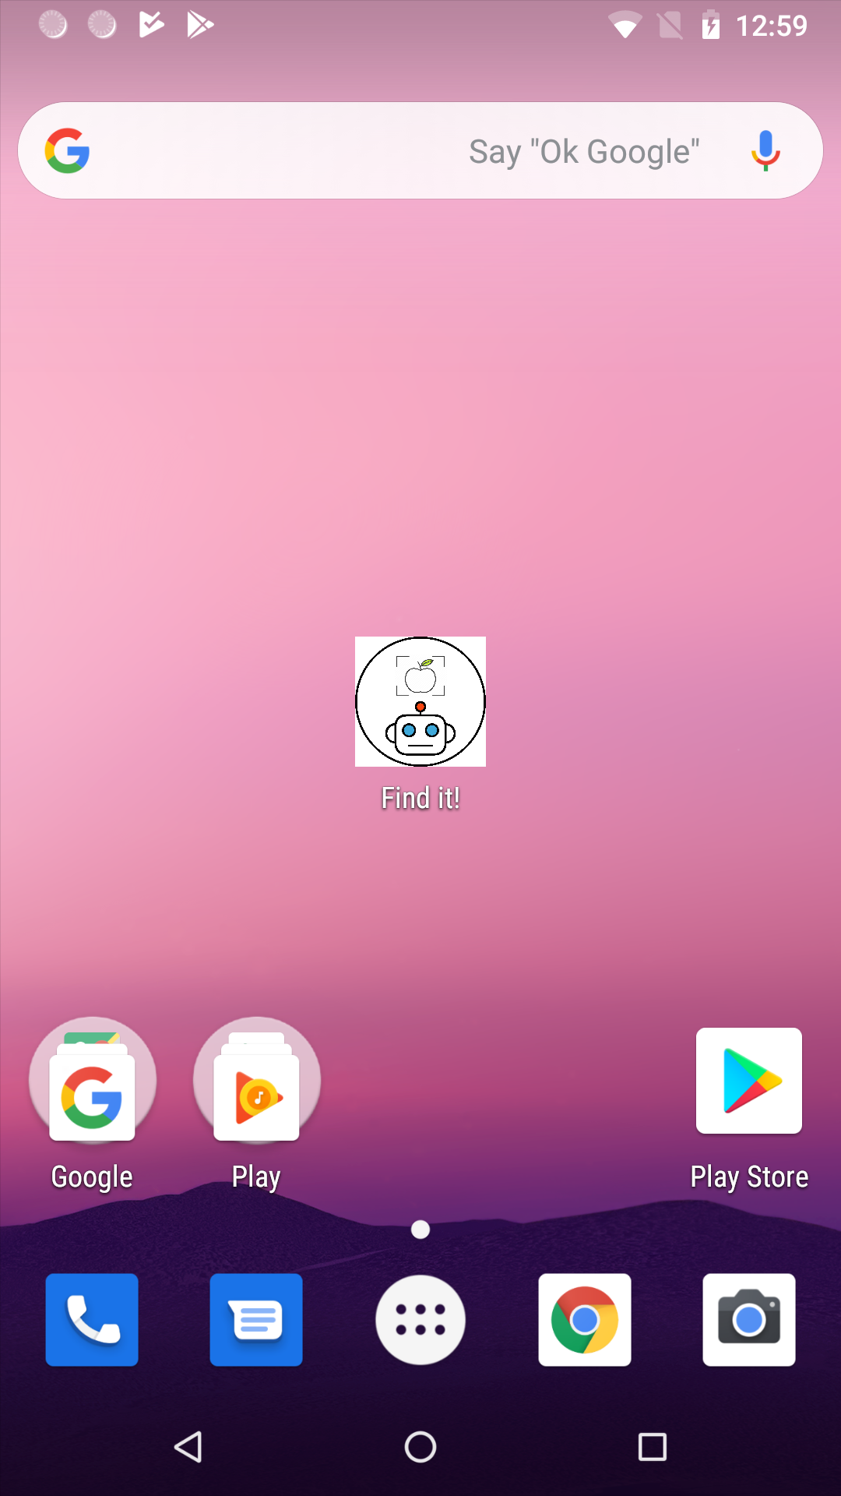
Let’s launch the app!
Place your screenshot here

Slide 6
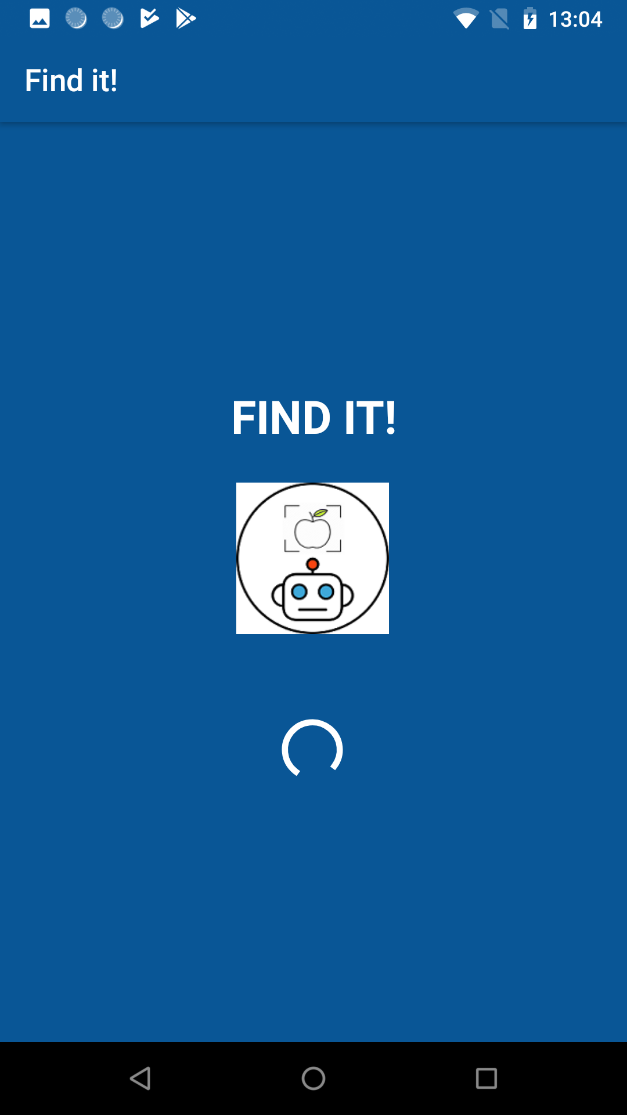
Place your screenshot here

Slide 7
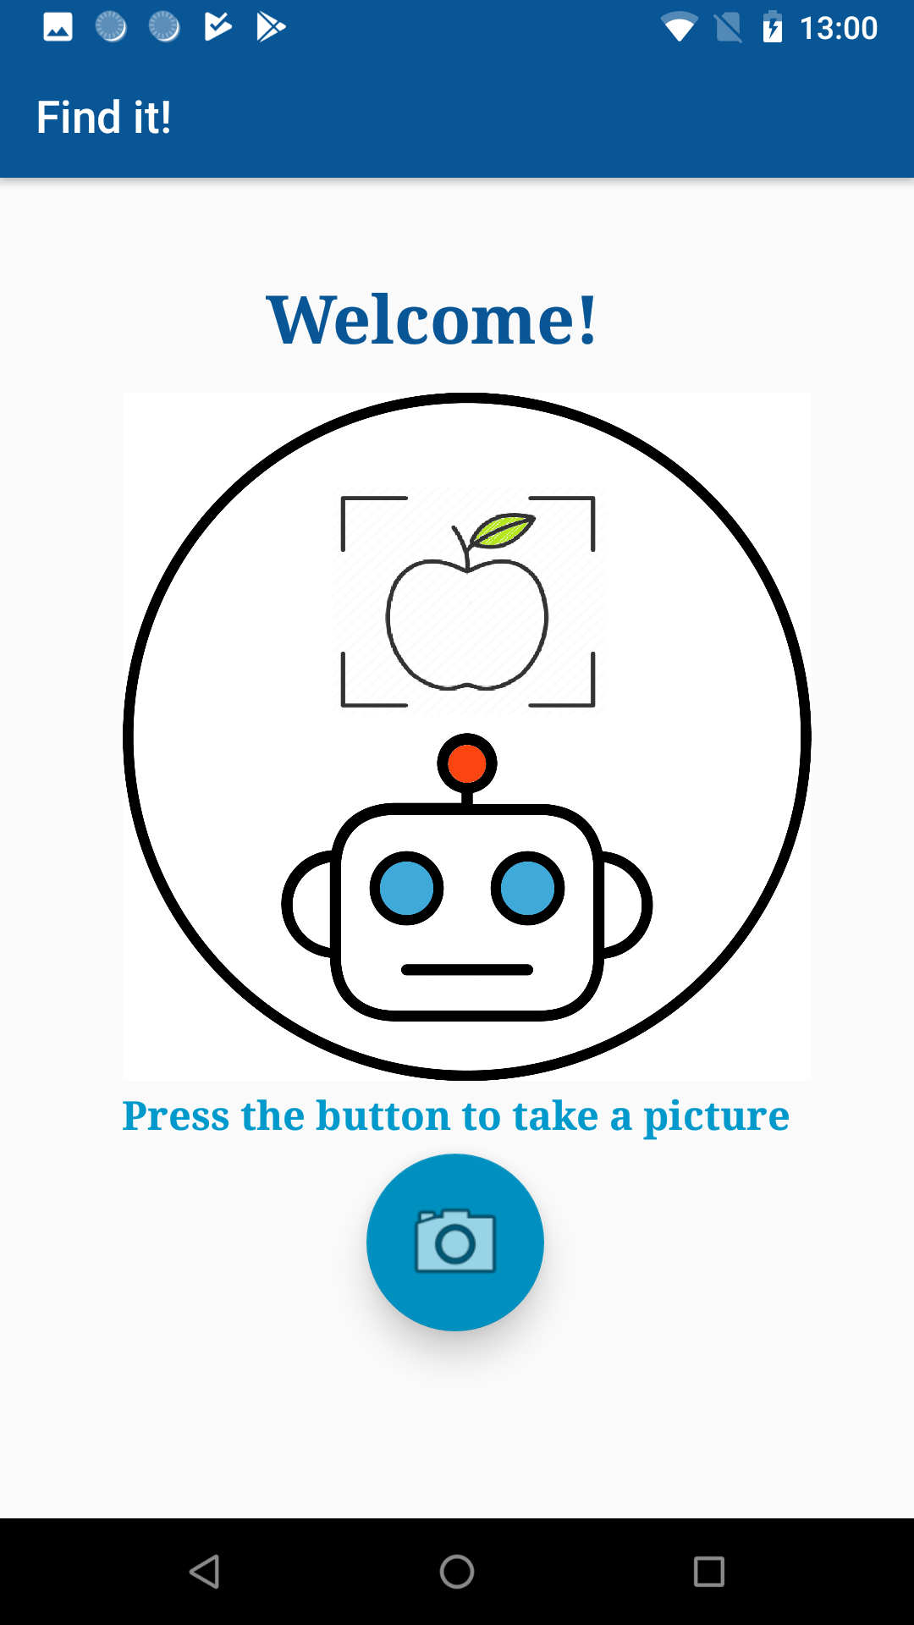
Place your screenshot here

Slide 8
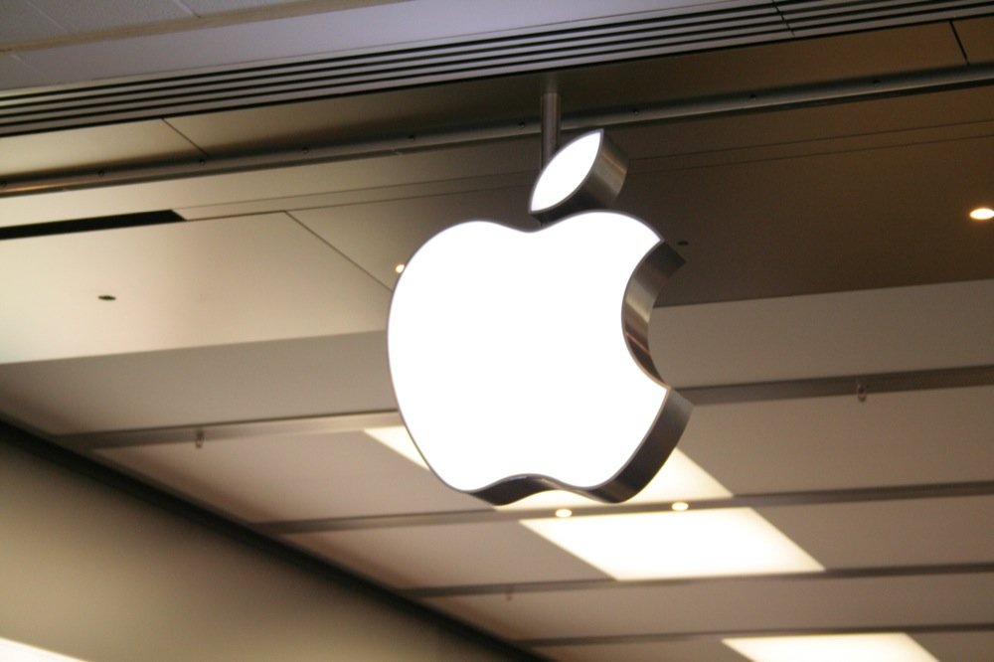
The user takes a picture!

Slide 9
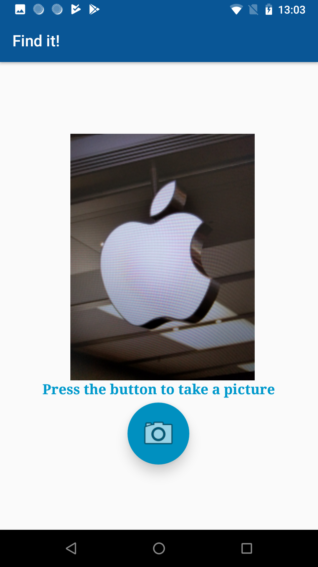
Place your screenshot here
It’s the Apple Logo!

